Slide 1
Manuscript Figures

Slide 2
Simple Training and Testing Diagrams

Slide 3
Simple Training Diagram
inputs
model
results
performance
weights
update

Slide 4
Simple Testing Diagram
inputs
model
results

Slide 5
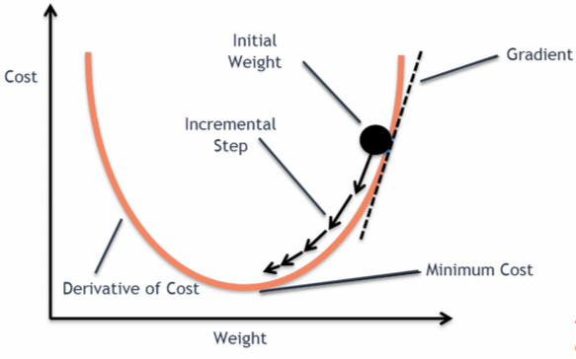

Slide 6
Nodal Architecture Representations

Slide 7

Simple Single-Output Regression Model
N-Node Hidden Layer
5-Node Input Layer
.
.
.
Temperature [K]
Pressure [Pa]
Relative Humidity [%]
predicted $\log_{10}\left(C_{n}^{2}\right)$
Wind Speed [m/s]
Solar Irradiance [W/m²]
.
.
.

Slide 8



Simple Multiple-Output Regression Model
N-Node Hidden Layer
5-Node Input Layer
.
.
.
3-Node Output Layer
Temperature [K]
Pressure [Pa]
1st forecast $\log_{10}\left(C_{n}^{2}\right)$
Relative Humidity [%]
2nd forecast $\log_{10}\left(C_{n}^{2}\right)$
Wind Speed [m/s]
3rd forecast $\log_{10}\left(C_{n}^{2}\right)$
Solar Irradiance [W/m²]
.
.
.

Slide 9
















Multi-Input Multi-Output MLP
N-Node Hidden Layer
N-Node Hidden Layer
($N_{t}$ X 6)-Node Input Layer
1st Temperature [K]
.
.
.
.
.
.
.
.
.
.
.
.
.
.
.
.
.
.
.
.
1st Pressure [Pa]
8-Node Output Layer
1st Relative Humidity [%]
1st Wind Speed [m/s]
1st forecast $\log_{10}\left(C_{n}^{2}\right)$
1st Solar Irradiance [W/m²]
2nd forecast $\log_{10}\left(C_{n}^{2}\right)$
1st Turbulence $\left(C_{n}^{2}\right)\left[m^{\left(−2/3\right)}\right]$
3rd forecast $\log_{10}\left(C_{n}^{2}\right)$
.
.
.
4th forecast $\log_{10}\left(C_{n}^{2}\right)$
5th forecast $\log_{10}\left(C_{n}^{2}\right)$
$t^{th}$ Temperature [K]
6th forecast $\log_{10}\left(C_{n}^{2}\right)$
.
.
.
.
.
.
.
.
.
.
.
.
.
.
.
.
.
.
.
.
$t^{th}$ Pressure [Pa]
7th forecast $\log_{10}\left(C_{n}^{2}\right)$
$t^{th}$ Relative Humidity [%]
8th forecast $\log_{10}\left(C_{n}^{2}\right)$
$t^{th}$ Wind Speed [m/s]
$t^{th}$ Solar Irradiance [W/m²]
$t^{th}$ Turbulence $\left(C_{n}^{2}\right)\left[m^{\left(−2/3\right)}\right]$

Slide 10














Single-Layer RNN Nodal Architecture
N-Node Hidden Recurrent Layer
8-Node Output Layer
.
.
.
.
.
.
6-Node Input Layer
1st forecast $\log_{10}\left(C_{n}^{2}\right)$
$t^{th}$ Temperature [K]
2nd forecast $\log_{10}\left(C_{n}^{2}\right)$
$t^{th}$ Pressure [Pa]
3rd forecast $\log_{10}\left(C_{n}^{2}\right)$
$t^{th}$ Relative Humidity [%]
4th forecast $\log_{10}\left(C_{n}^{2}\right)$
$t^{th}$ Wind Speed [m/s]
5th forecast $\log_{10}\left(C_{n}^{2}\right)$
$t^{th}$ Solar Irradiance [W/m²]
6th forecast $\log_{10}\left(C_{n}^{2}\right)$
.
.
.
.
.
.
7th forecast $\log_{10}\left(C_{n}^{2}\right)$
$t^{th}$ Turbulence $\left(C_{n}^{2}\right)\left[m^{\left(−2/3\right)}\right]$
8th forecast $\log_{10}\left(C_{n}^{2}\right)$

Slide 11







Unrolled Single-Layer RNN
$$h_{t}$$
$$h_{0}$$
$$h_{1}$$
$$h_{t}$$
RNN Cell
RNN Cell
RNN Cell
RNN Cell
$$x_{t}$$
$$x_{0}$$
$$x_{1}$$
…
$$x_{t}$$
$$x_{t}={\left(temp, press, RH, wind spd, solar irr, C_{n}^{2}\right)}_{t}$$

Slide 12












Unrolled Single-Layer RNN to Output
N-Node $h_{t}$
8-Node Output Layer
.
.
.
.
.
.
1st forecast $\log_{10}\left(C_{n}^{2}\right)$
0
$$h_{0}$$
$$h_{1}$$
$$h_{t}$$
2nd forecast $\log_{10}\left(C_{n}^{2}\right)$
3rd forecast $\log_{10}\left(C_{n}^{2}\right)$
RNN Cell
RNN Cell
RNN Cell
4th forecast $\log_{10}\left(C_{n}^{2}\right)$
5th forecast $\log_{10}\left(C_{n}^{2}\right)$
6th forecast $\log_{10}\left(C_{n}^{2}\right)$
$$x_{0}$$
$$x_{1}$$
…
$$x_{t}$$
.
.
.
.
.
.
7th forecast $\log_{10}\left(C_{n}^{2}\right)$
8th forecast $\log_{10}\left(C_{n}^{2}\right)$
$$x_{t}={\left(temp, press, RH, wind spd, solar irr, C_{n}^{2}\right)}_{t}$$

Slide 13














Multi-Layer RNN Nodal Architecture
N-Node Hidden Recurrent Layer
N-Node Hidden Recurrent Layer
8-Node Output Layer
.
.
.
.
.
.
.
.
.
.
.
.
6-Node Input Layer
1st forecast $\log_{10}\left(C_{n}^{2}\right)$
$t^{th}$ Temperature [K]
2nd forecast $\log_{10}\left(C_{n}^{2}\right)$
$t^{th}$ Pressure [Pa]
3rd forecast $\log_{10}\left(C_{n}^{2}\right)$
$t^{th}$ Relative Humidity [%]
4th forecast $\log_{10}\left(C_{n}^{2}\right)$
$t^{th}$ Wind Speed [m/s]
5th forecast $\log_{10}\left(C_{n}^{2}\right)$
$t^{th}$ Solar Irradiance [W/m²]
6th forecast $\log_{10}\left(C_{n}^{2}\right)$
.
.
.
.
.
.
.
.
.
.
.
.
7th forecast $\log_{10}\left(C_{n}^{2}\right)$
$t^{th}$ Turbulence $\left(C_{n}^{2}\right)\left[m^{\left(−2/3\right)}\right]$
8th forecast $\log_{10}\left(C_{n}^{2}\right)$

Slide 14









Unrolled Multi-Layer RNN
$$h_{t}^{\left(2\right)}$$
$$h_{0}^{\left(2\right)}$$
$$h_{1}^{\left(2\right)}$$
$$h_{t}^{\left(2\right)}$$
RNN Cell
RNN Cell
RNN Cell
RNN Cell
$$h_{t}^{\left(1\right)}$$
$$h_{0}^{\left(1\right)}$$
$$h_{1}^{\left(1\right)}$$
…
$$h_{t}^{\left(1\right)}$$
RNN Cell
RNN Cell
RNN Cell
RNN Cell
$$x_{t}$$
$$x_{0}$$
$$x_{1}$$
…
$$x_{t}$$
$$x_{t}={\left(temp, press, RH, wind spd, solar irr, C_{n}^{2}\right)}_{t}$$

Slide 15















Unrolled Multi-Layer RNN to Output
N-Node $h_{t}$
8-Node Output Layer
0
$$h_{0}^{\left(2\right)}$$
$$h_{1}^{\left(2\right)}$$
$$h_{t}^{\left(2\right)}$$
.
.
.
.
.
.
1st forecast $\log_{10}\left(C_{n}^{2}\right)$
RNN Cell
RNN Cell
RNN Cell
2nd forecast $\log_{10}\left(C_{n}^{2}\right)$
3rd forecast $\log_{10}\left(C_{n}^{2}\right)$
…
4th forecast $\log_{10}\left(C_{n}^{2}\right)$
0
$$h_{0}^{\left(1\right)}$$
$$h_{1}^{\left(1\right)}$$
$$h_{t}^{\left(1\right)}$$
5th forecast $\log_{10}\left(C_{n}^{2}\right)$
RNN Cell
6th forecast $\log_{10}\left(C_{n}^{2}\right)$
RNN Cell
RNN Cell
.
.
.
.
.
.
7th forecast $\log_{10}\left(C_{n}^{2}\right)$
8th forecast $\log_{10}\left(C_{n}^{2}\right)$
$$x_{0}$$
$$x_{1}$$
…
$$x_{t}$$
$$x_{t}={\left(temp, press, RH, wind spd, solar irr, C_{n}^{2}\right)}_{t}$$

Slide 16
Simple RNN, LSTM-RNN, and GRU-RNN Cells

Slide 17






RNN Cell
$$h_{t−1}$$
$$h_{t}$$
$$h_{t+1}$$
RNN Cell
RNN Cell
tanh
$$x_{t−1}$$
$$x_{t}$$
$$x_{t+1}$$

Slide 18



LSTM-RNN Cell (NOT FINISHED)
$$h_{t−1}$$
$$h_{t}$$
$$h_{t+1}$$
LSTM-RNN Cell
LSTM-RNN Cell
X
+
X
X
σ
σ
tanh
σ
$$x_{t−1}$$
$$x_{t}$$
$$x_{t+1}$$

Slide 19
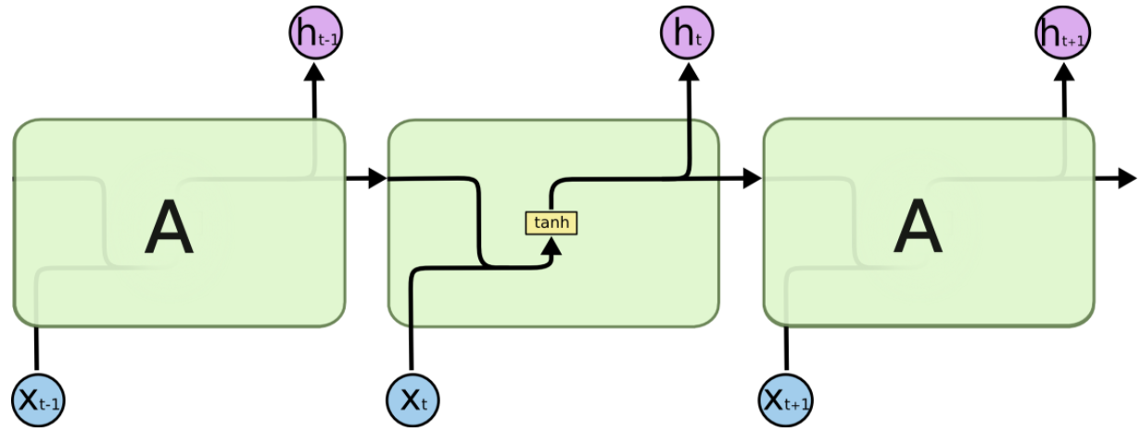
Simple-RNN Cell Colah’s Blog

Slide 20
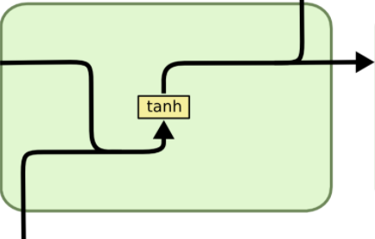



Simple-RNN Cell Colah’s Blog
$$h_{t−1}$$
$$h_{t}$$
$$x_{t}$$

Slide 21
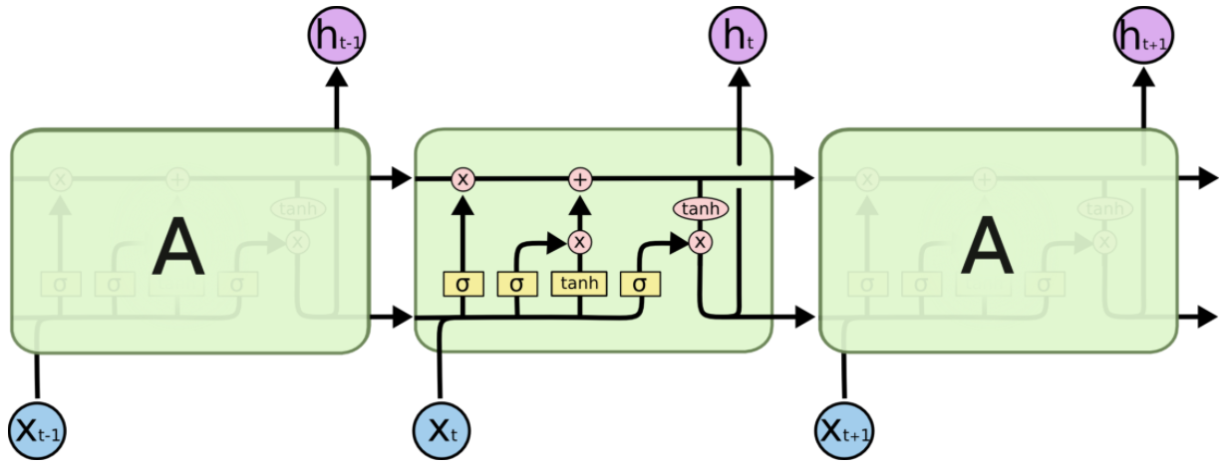
LSTM-RNN Cell Colah’s Blog

Slide 22
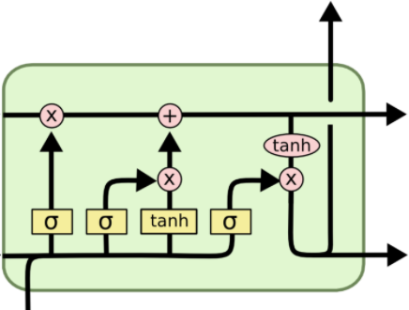










LSTM-RNN Cell Colah’s Blog
$$h_{t}$$
$$C_{t}$$
$$C_{t−1}$$
$$f_{t}$$
$$i_{t}$$
$$o_{t}$$
$$g_{t}$$
$$h_{t−1}$$
$$h_{t}$$
$$x_{t}$$

Slide 23
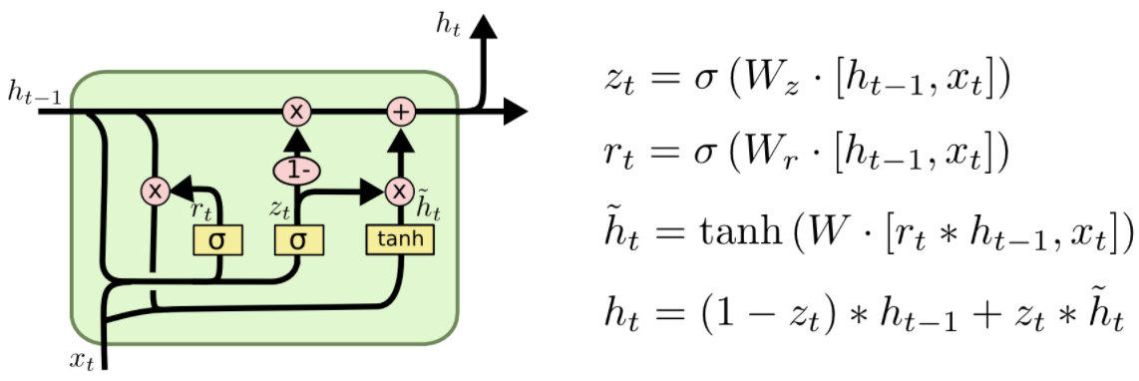
GRU-RNN Cell Colah’s Blog

Slide 24
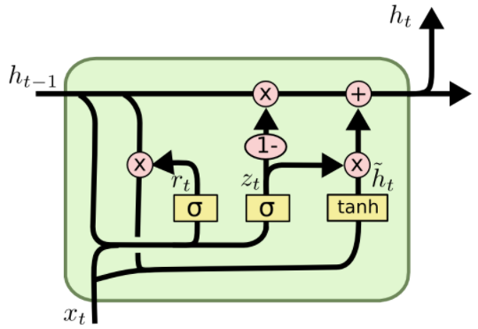







GRU-RNN Cell Colah’s Blog
$$h_{t}$$
$$h_{t−1}$$
$$h_{t}$$
$$r_{t}$$
$$z_{t}$$
$$n_{t}$$
$$x_{t}$$

Slide 25
Experimental Setup Figures

Slide 26
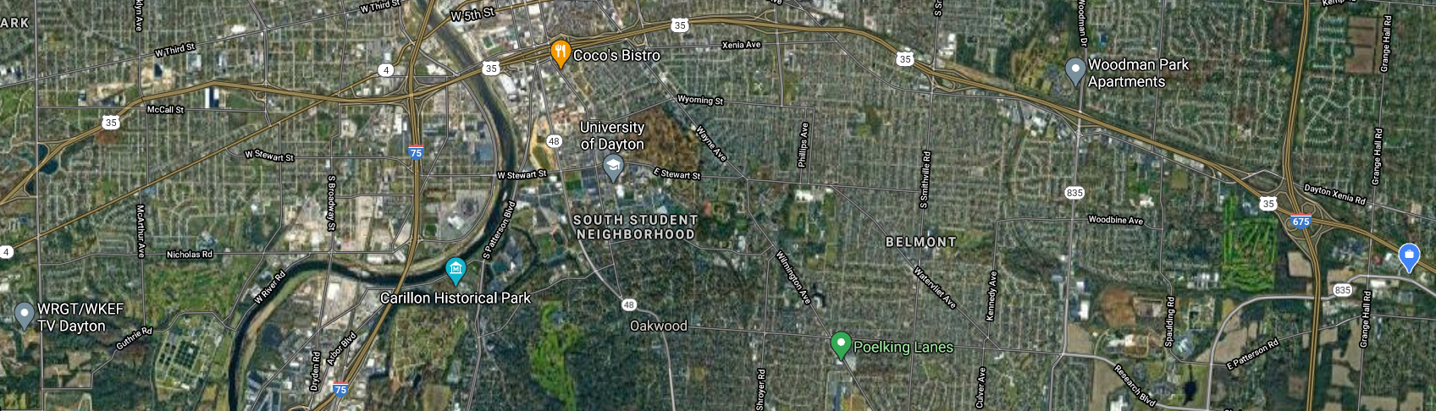
N
W
E
Platform: DELTA
5th Floor Fitz Hall
39.738326, -84.182262
S
Range: 8.87 km
Platform: Weather Station
39.730228, -84.079031
Target: Y-Tower
39.724623, -84.254897
Range: 6.40 km
Range: 15.05 km

Slide 27
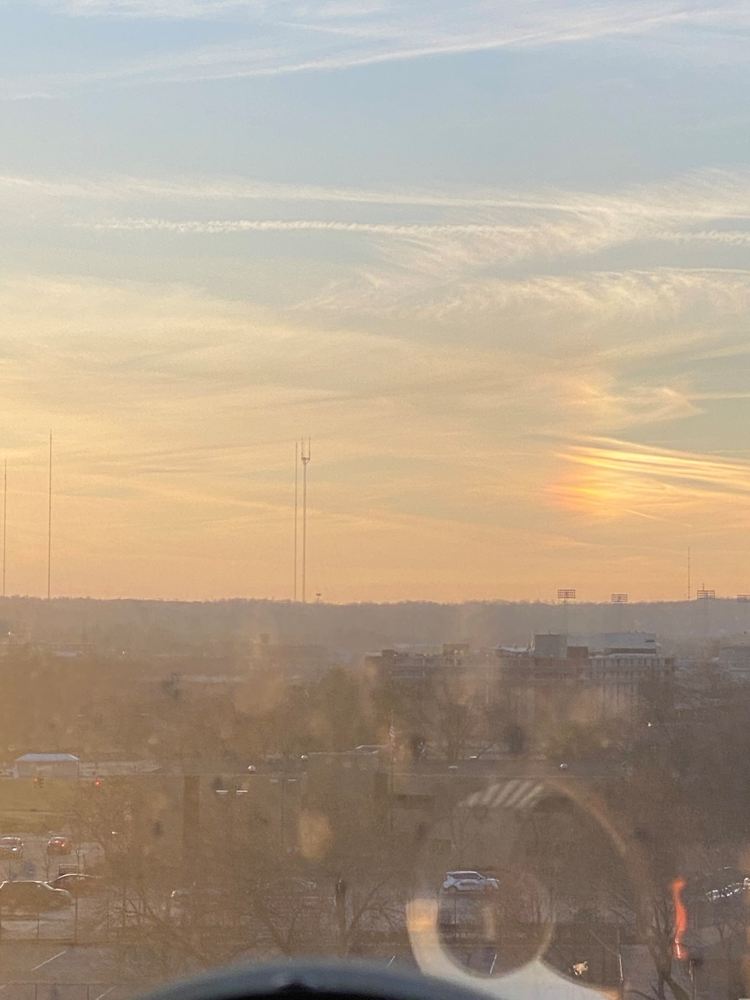
Target: Y-Tower

